Slide 1

6.

Slide 2
Agenda new
What is a bug? Bug types.
Root cause analysis. Examples.
Priority and severity of a defect
Bug Template
Defect’s lifecycle
Bug attachments
Issue Management Tool
HW6

Slide 3

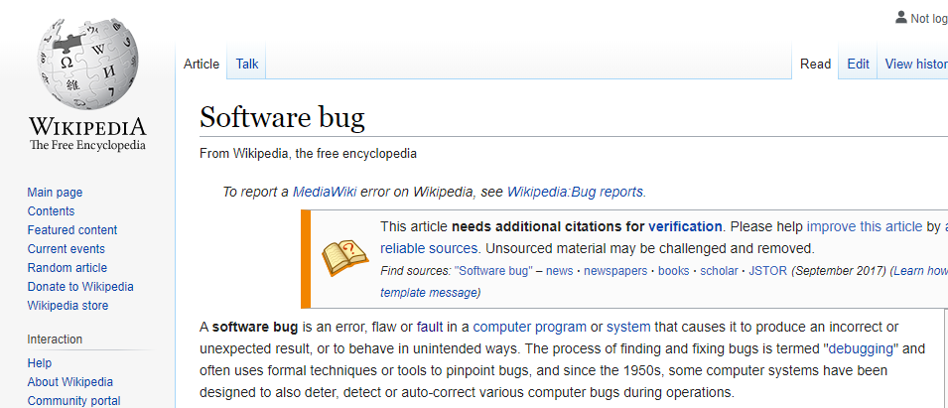
What is a bug?
In software engineering, mistake metamorphism (from Greek meta = "change", morph = "form") refers to the evolution of a defect in the final stage of software deployment. Transformation of a "mistake" committed by an analyst in the early stages of the software development lifecycle, which leads to a "defect" in the final stage of the cycle has been called 'mistake metamorphism'.
Different stages of a "mistake" in the entire cycle may be described as "mistakes", "anomalies", "faults", "failures", "errors", "exceptions", "crashes", "bugs", "defects", "incidents", or "side effects".
Notes:
What was the first use of the term "bug"?
Although the term "Computer Bug" is a relatively recent construct (i.e. only applied to IT with the rise of computers) the term 'bug' has been used in informal engineering terminology for some time.
The very concept, though not the term, might date as far back as 1843 when Ada Lovelace spoke about the possibility of problematic program "cards" used in Charles Babbage's analytical engine.
In an 1843 letter, she noted:-
"an analyzing process must equally have been performed in order to furnish the Analytical Engine with the necessary operative data, and that herein may also lie a possible source of error. Granted that the actual mechanism is unerring in its processes, the cards may give it wrong orders."
The first recorded use of the term 'bug', with regards to being an error or malfunction in a machine, comes from none other than Thomas Edison. In an 1878 letter to an associate (which was sold in an auction in 2018), he noted:-
“You were partly correct, I did find a ‘bug’ in my apparatus, but it was not in the telephone proper. It was of the genus ‘callbellum.’ The insect appears to find conditions for its existence in all call apparatus of telephones.”
The term "bug" was used in an account by computer pioneer Grace Hopper, who publicized the cause of a malfunction in an early electromechanical computer.^{[9]} A typical version of the story is:
In 1946, when Hopper was released from active duty, she joined the Harvard Faculty at the Computation Laboratory where she continued her work on the Mark II and Mark III. Operators traced an error in the Mark II to a moth trapped in a relay, coining the term bug. This bug was carefully removed and taped to the log book. Stemming from the first bug, today we call errors or glitches in a program a bug.^{[10]}

Slide 4
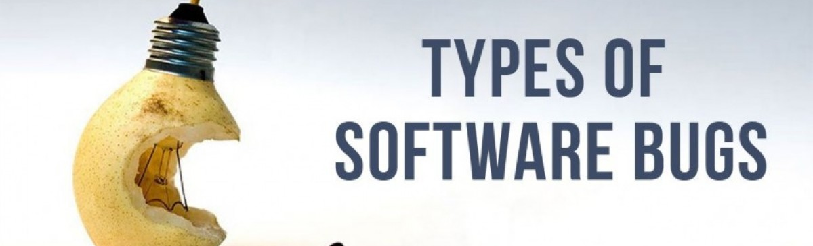
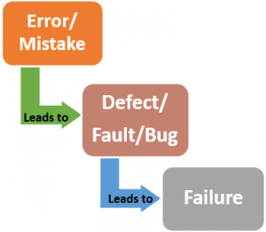
Based on IEEE610.12-90, the definitions of bug:
Mistake: A human action that produces an incorrect result.
Fault: An incorrect step, process, or data definition in a computer program
Error: A difference...between a computed result and the correct result
Failure: The [incorrect] result of a fault
Types of Errors
Incorrect calculations
Functional errors
Error handling errors
Communication errors
Syntactic errors
Missing command errors
Boundary related errors
Notes:
There is no software without bugs. Every day testers all over the world encounter new and new software defects and issues. But some of them have become sort of common as they appear more frequently than others.
Today we are going to identify the most common types of bugs all testers should know. This will help to look for software issues in the most likely places instead of performing a random search. Also, testers can face unusual software bugs.
Incorrect calculations
This type of problem can be caused by a lot of reasons, e.g., wrong algorithm, data type mismatch or just coding errors. Sometimes, a cost of these bugs can be very high. History knows a lot of examples when a wrong number provoked accidents or huge financial losses.
For example, let’s remember the famous Ariane 5, a rocket developed by the European Space Agency. It was supposed to float in space but in reality, ended up exploding only 40 seconds after its launching. Money losses were estimated at $500 million. The reason was an unpredictable conversion from a 64-bit floating point number to a 16-bit signed integer value. As a result, 16 bits were not enough to represent the necessary value, so calculations went wrong.
Functional errors
All the functionality of any program should operate correctly. It means that an expected result of operations should coincide with an actual one. But often they don’t. As far as there are programs, which have quite a big range of functions, there is a great probability of bug omission. Such type of errors can vary from unclickable buttons to inability to use the main functionality of the software.
Error handling errors
All the software problems occurred during an interaction with the user should be handled successfully. Besides, a user should be clearly informed about the cause of the problem and possible ways out. If a user types something incorrectly, he / she should receive a quite informative message not to do the same mistake again. There is a good example. In 1997 the USS Yorktown, a US Navy warship, drifted for two hours because of a software crash. A crew member typed “0” to the database and made the computer divide by zero. That caused a buffer overrun and led to the program crash and loss of ship control.
Communication errors
Software should be easy to use and provide all necessary instructions and recommendations for users to interact with a program. Sometimes it happens that a new feature is implemented, but you cannot find it even using documentation. Also, if you have uploaded a file or have sent a letter, you should receive a message with the operation status. Haven’t received it? That is it – a communication error. Errors of this type seem not so serious but, actually, they can make your customers select your competitor instead of you.
Syntactic errors
We all are humans and may make grammar mistakes. Especially, it happens when the product is translated into different languages. While testing GUI of the product, it is important to switch languages and check the correspondence of the elements with the documentation. Just take a look at this contradictory message received from Remmina Remote Desktop Client. The word “success” is probably pasted by mistake, but it can perplex users for some time.
Missing command errors
Sometimes it happens, that you cannot close a pop-up window without performing some actions, even if you don’t want to. This is missing command errors. That can be not only the absence of button but also the absence of a logical option.
Boundary related errors
In our life, everything has a limit. The same we can say about software resources. Maximum text size, maximum number of simultaneous users, memory limit allocated for one element – if all of this is not anticipated by developers it will definitely cause problems.
Probably, the most famous problem of this type is the “Year 2000 problem” or so-called “Millennium bug”. Previously, in the majority of programs, years were represented only with two digests, e.g. 85 or 98, which meant 1985 and 1998 respectively. The problem arose when it came to 2000 because computer systems would have interpreted it as 1900. Though the problem was anticipated, it still cost around 300 billion dollars throughout the world to deal with the problem.

Slide 5
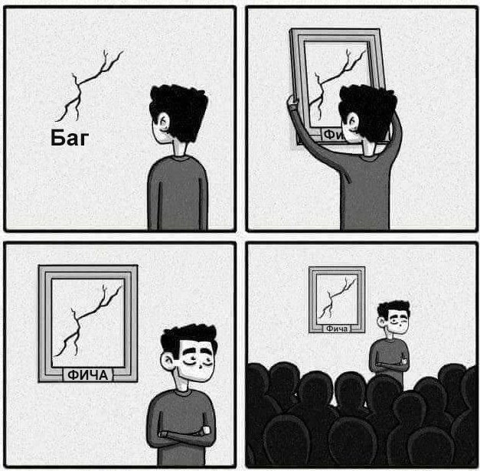
Notes:
It's not a bug, it's a feature
Excuse made by software developers when they try to convince the user that a flaw in their program is actually what it's supposed to be doing.
User: When I am on the item detail screen and click on "delete this item", the program returns to to the item overview screen and the item is still there. Developer: Your access permissions don't allow you to delete items. It's not a bug, it's a feature.
Examples:
Gmail's "undo" feature came about as a way to deal with a five-second delay
Yes, the undo feature that we see now on Gmail, actually was born out of a bug. Gmail went through 5 seconds delay while processing an email. Developers who were working on Gmail smartly turned that bug into the most useful feature of Gmail.
Hidden files in Linux
The feature that we use in Linux and Unix where we hide our files by simply putting a dot(.) before the filename. Well, it was a bug in Linux and Unix which wasn’t fixed.
CTRL + ALT + DEL
Control-Alt-Delete is the invention of David Bradley, the developer who worked on the first IBM PC. He invented the command to help programmers save time by booting without having to wait for shutdown so that the flow of their work would not be interrupted. It was never his intention for the three-finger salute to become so familiar to end users.
Функция мягкой перезагрузки с помощью клавиатуры изначально была разработана Дэвидом Брэдли.^{[1]} Брэдли, главный инженер проекта IBM PC и разработчик машин ROM-BIOS, изначально использовал Ctrl+Alt+Esc, но потом решил, что можно случайно нажать клавиши в левой части клавиатуры и перезагрузить компьютер. Поэтому главный программист проекта предложил использовать комбинацию клавиш Ctrl+Alt+Del в качестве меры безопасности. На клавиатуре IBM PC такую комбинацию невозможно нажать только одной рукой.^{[2][3]}
Изначально особенность была задумана только как пасхальное яйцо и не была предназначена для использования конечными пользователями, поскольку она вызывает перезагрузку без предупреждения и дальнейшего подтверждения. Комбинация клавиш предназначалась для использования людьми, пишущими программы и документацию, чтобы они могли перезагружать свои компьютеры без их выключения. Билл Гейтс (основатель Microsoft) говорил об этом так: «То, что мы используем при разработке, не будет доступно где-либо ещё».^{[4]} Однако эта особенность была описана в технической документации IBM к ПК, и тем самым она стала известна общественности.

Slide 6
Agenda new
What is a bug? Bug types.
Root cause analysis. Examples.
Priority and severity of a defect
Bug Template
Defect’s lifecycle
Bug attachments
Issue Management Tool
HW6

Slide 7

Incident
Any event occurring that requires investigation.
Notes:
Root Cause Analysis should be performed.

Slide 8
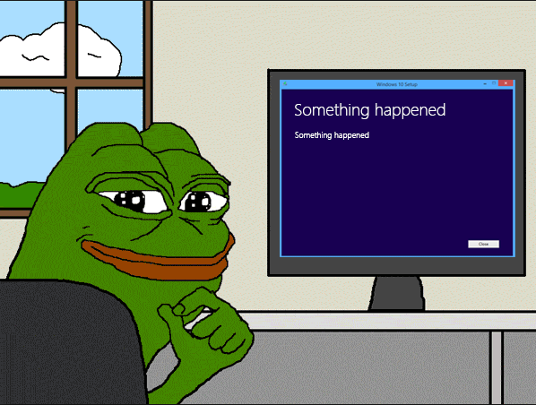


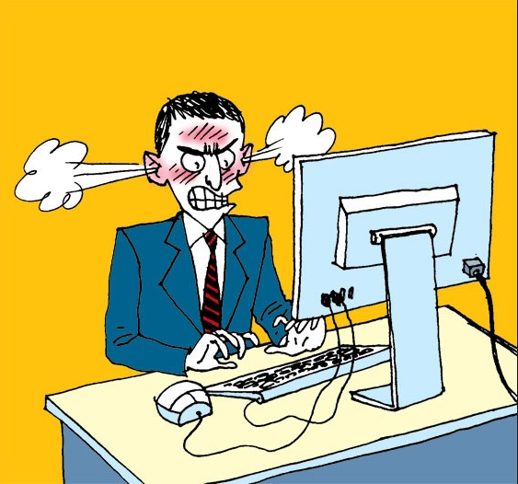
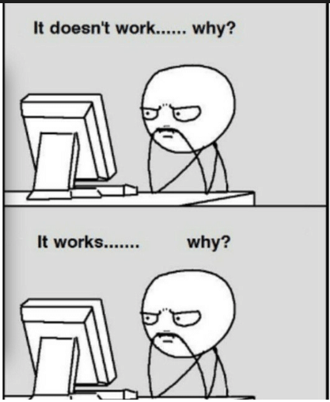
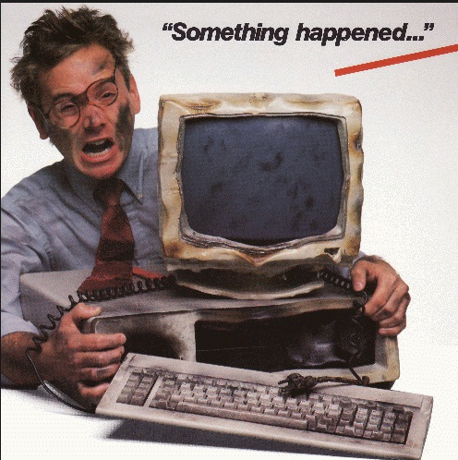
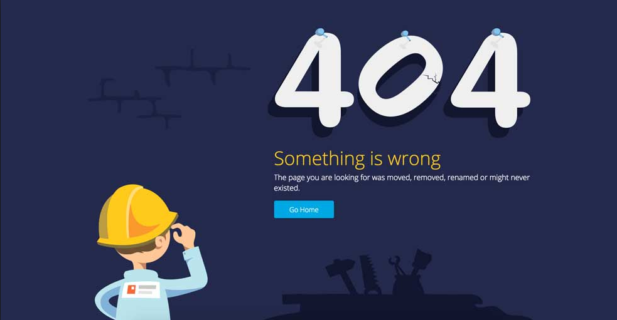
Something happened
Notes:
Something happened => incident. We need to investigate and find the root cause of this incident.

Slide 9
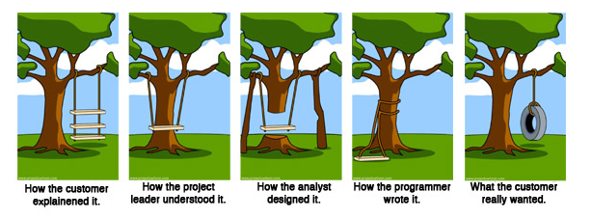
How it might happen

Slide 10
Incorrect test case
Corrupted test data
Incorrect configuration of a test environment
Incorrect requirement
Incident
Tester’s/User’s mistake
Lost internet connection
…
Defect
…

Slide 11
Root Cause Analysis (RCA)
Root cause analysis (RCA) is defined as a collective term that describes a wide range of approaches, tools, and techniques used to uncover causes of problems. Some RCA approaches are geared more toward identifying true root causes than others, some are more general problem-solving techniques, and others simply offer support for the core activity of root cause analysis.
Root Cause Analysis (RCA) is a popular and often-used technique that helps people answer the question of why the problem occurred in the first place. It seeks to identify the origin of a problem using a specific set of steps, with associated tools, to find the primary cause of the problem, so that you can:
Determine what happened.
Determine why it happened.
Figure out what to do to reduce the likelihood that it will happen again.
You'll usually find three basic types of causes:
Physical causes – Tangible, material items failed in some way (for example, a car's brakes stopped working).
Human causes – People did something wrong, or did not do something that was needed. Human causes typically lead to physical causes (for example, no one filled the brake fluid, which led to the brakes failing).
Organizational causes – A system, process, or policy that people use to make decisions or do their work is faulty (for example, no one person was responsible for vehicle maintenance, and everyone assumed someone else had filled the brake fluid).

Slide 12
Simple Steps To Analyze The Root Caus
BUG DESCRIPTION
First, we need to collect the first information you received about the bug. The focus is on the problem analysis. Avoid thinking about technical solutions.
DEFINE THE PROBLEM SCOPE
Clarify the following points:
How many users are affected?
How long was the bug undetected?
Is there a feasible workaround for the users?
If required, you can define short-term measures to reduce the impact of the bug. For example, inform your users or stakeholders about the bug.
“5 WHYS” METHOD
After creating a clear picture of the problem, we can start to analyze the root cause of the software bug using the 5 Whys method. Start with your problem description and ask multiple times “Why?” to figure out the cause for each problem. The basic theory behind this is that every cause has an effect. Here, the visible effect is the bug you want to fix. For difficult bugs, the root cause is likely hidden behind another cause. There will be a sequence of causes and their effects that finally produced the bug.
With the 5 Whys method, we want to track this sequence backward to find the root cause of the software bug.
“IS / IS NOT” method
One more method to analyze and/or describe the bug. The process deconstructs the Problem into 4 logical components, What the problem is, Where the problem occurs, When it occurs and the Extent to which it occurred.
ROOT CAUSE DESCRIPTION
After we found the root cause, we need to write it done. It is very simple but it will help you to check again if there are any unclear points. Your colleagues need to understand it as well. In addition, you should think about why the bug was not detected until now and how to avoid it in the future.
Notes:
Sources:
https://www.software-has-bugs.com/2018/04/04/analyse-the-root-cause-of-software-bugs/
5 Whys technique
https://en.wikipedia.org/wiki/Five_whys
IS/IS Not method
https://iancos.wordpress.com/2013/01/18/is-but-is-not-method/

Slide 13
Agenda new
What is a bug? Bug types.
Root cause analysis. Examples.
Priority and severity of a defect
Bug Template
Defect’s lifecycle
Bug attachments
Issue Management Tool
HW6

Slide 14
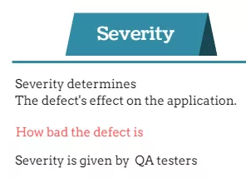
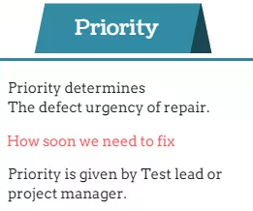
Severity and priority of a defect

Slide 15
Severity and priority levels
Blocker: The defect totally blocks the testing. It cannot be continued.
Critical: The defect affects critical functionality or critical data. It does not have a workaround. Example: Unsuccessful installation, complete failure of a feature.
Major: The defect affects major functionality or major data. It has a workaround but is not obvious and is difficult. Example: A feature is not functional from one module but the task is doable if 10 complicated indirect steps are followed in another module/s.
Minor: The defect affects minor functionality or non-critical data. It has an easy workaround. Example: A minor feature that is not functional in one module but the same task is easily doable from another module.
Trivial: The defect does not affect functionality or data. It does not even need a workaround. It does not impact productivity or efficiency. It is merely an inconvenience. Example: Petty layout discrepancies, spelling/grammatical errors.
Critical: Must be fixed immediately / in the next build.
High: Must be fixed in any of the upcoming builds but should be included in the release.
Medium: May be fixed after the release / in the next release.
Low: May or may not be fixed at all.

Slide 16
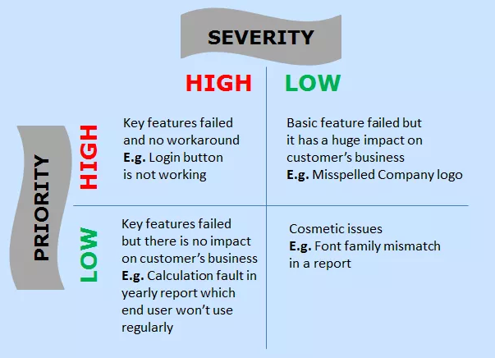
Priority vs Severity

Slide 17
Agenda new
What is a bug? Bug types.
Root cause analysis. Examples.
Priority and severity of a defect
Bug Template
Defect’s lifecycle
Bug attachments
Issue Management Tool
HW6

Slide 18
Efficient Defect Report
Before reporting a defect always reproduce and localize it first!
- summary is meaningful & self-descriptive enough to tell about the defect
- summary is short & properly conveys the defect description without further reading
- add proper, sequential and clear steps to reproduce
- add preconditions, environment and test data information, if relevant
- don’t miss anything, which makes a defect non-reproducible
- no complicated words and unwanted information – only relevant content
- be specific: description is to the point – no essay writing about the problem
- single defect should cover only single problem or similar problems
- description is clear and precise
- meaningful sentences and simple words
- add references to specifications or other related defect id
- don’t take business decisions, only pass the Information: be objective and add the actual result & the expected result if the requirements are specified, otherwise ask responsible persons to clarify the behavior (for example, business analysts)
- think carefully of priority and severity of a defect
- add attachments if can help
- avoid mistakes in the report
Notes:
The defect should be reported in efficient way & use of words such that the programmer or team members reading the report cannot get confused or rejected the defect the reason “Not Reproducible”.
If your bug report is effective, chances are higher that it will get fixed. So fixing a bug depends on how effectively you report it. Reporting a bug is nothing but a skill.
convey - передавать

Slide 19
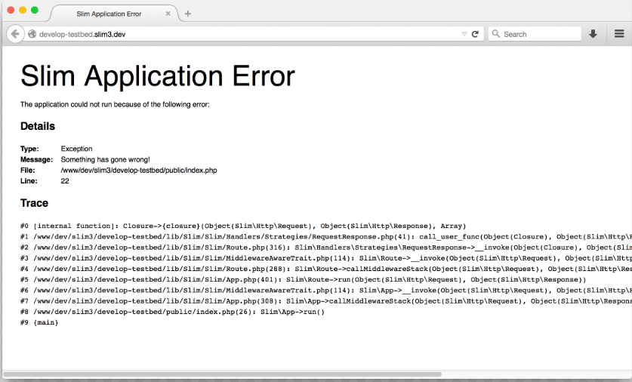
Defect Report example
You want to create a new user with user information.
For that you need to login into the application and navigate to USERS menu > New User, then enter all the details in the ‘User form’ like, First Name, Last Name, Age, Address, Phone etc.
Once you enter all these information, you need to click on [SAVE] button in order to save the user. Now you can see a success message saying, “New User has been created successfully”.
But when you entered into your application by logging in and navigated to USERS menu > New user, entered all the required information to create the new user and clicked on [SAVE] button. BANG! The application crashed and you got one error page on the screen (corresponding screenshot with error message is captured and saved).

Slide 20
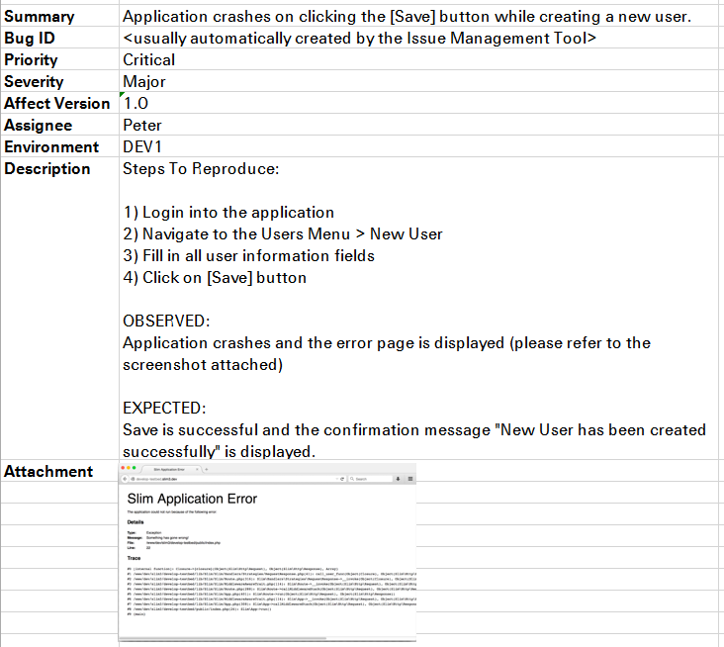

Slide 21
Agenda new
What is a bug? Bug types.
Root cause analysis. Examples.
Priority and severity of a defect
Bug Template
Defect’s lifecycle
Bug attachments
Issue Management Tool
HW6

Slide 22
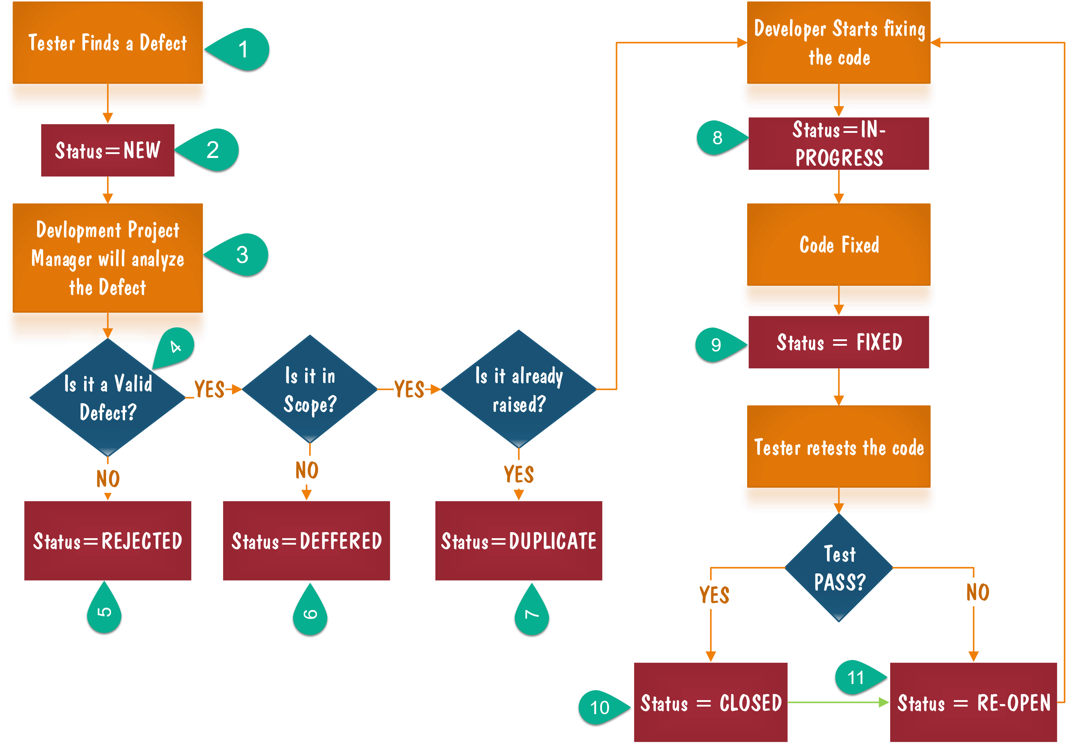
Defect lifecycle
Notes:
Fixed defect should be re-tested on correct version and its functionality should be re-tested around as well
deffered - отсроченный

Slide 23
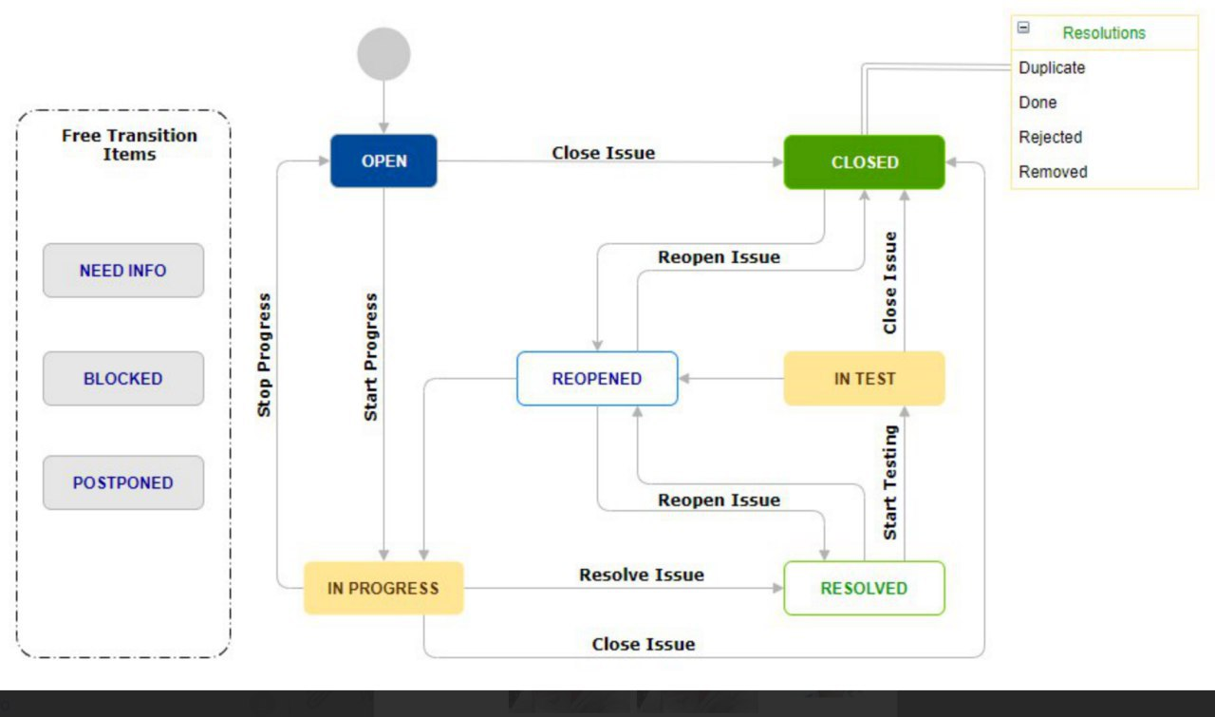
Defect Workflow
Notes:
Fixed defect should be re-tested on correct version and its functionality should be re-tested around as well
deffered – отсроченный - Postponed

Slide 24
Agenda new
What is a bug? Bug types.
Root cause analysis. Examples.
Priority and severity of a defect
Bug Template
Defect’s lifecycle
Bug attachments
Issue Management Tool
HW6

Slide 25
Issue Management Tool
Issue Management Tool or Issue Tracking System is a software, which allows to raise, to manage and to maintain issues.

Slide 26









Issue Management Tool’s examples

Slide 27
Logs
A Log file is a file that records either events that occur in an operating system or other software runs, or messages between different users of a communication software.
Logging is the act of keeping a log. In the simplest case, messages are written to a single log file.

Slide 28
Agenda
What are an error, a mistake, a defect, a bug, a fault?
What is a failure?
What is an incident?
Priority and severity of a defect
Issue Management Tool
Defect’s lifecycle
Efficient Defect Report
Log and Log Management Tool
HW6

Slide 29
HomeWork 6
Домашнее задание заключается в поиске и репортинге багов найденных в реальной системе.
Ссылка на обьект тестирования - strumok.com
Требования:
Зарегистрироваться в JavaGuru Джире (http://87.246.137.196:8081/projects/QAOL/)
Завести баги в джиру в проект "QAOL" по условиям Домашнего Задания ниже.
Заполнить такие обязательные поля: Summary, Description (Steps to reproduce, Actual result, Expected result, test data), Attachment (screenshot), Priority, остальные поля не заполняем!
Скидываем баги которые оформлены и ждут проверки в classroom с помощью следующего фильтра (http://87.246.137.196:8081/issues/?filter=-2) но меняем параметр Reporter на себя.
Домашнее задание:
Найти на указанном ресурсе баги и завести их в джиру в указанном формате.
По итогу от каждого должно быть минимум 3 баг репорта в джире.
Если вы не находите баги, пишите мне и я напишу где точно они есть.

Slide 30
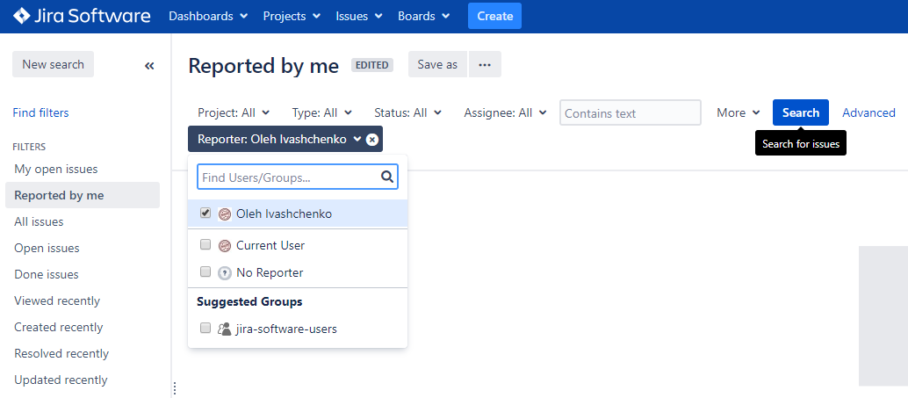
HomeWork 6

